Slide 1

ITC 6000 Database Management Systems Final Project Presentation Year Term 2023 Fall-B Plant Care Management System
Pruthvi Samir Patel
patel.pruthvi@northeastern.edu

Slide 2
Overview
Project Overview
User Persona’s
ER Diagram
Business Rules
Solution Architecture
Major SQL examples
Metrics
Security & Privacy Concerns
Next steps / Lessons learned

Slide 3

Project Overview
Name: Plant Care Assistant System (Cultiva Care).
Target Users: Farmers, agricultural professionals, and plant enthusiasts.
Primary Objective: Help user to take appropriate care of crops and plants.
Challenges Addressed:
Farmers: Natural and man-made challenges
e.g: soil erosion, climate change, depletion of water resources (M, 2023)
Gardeners:
e.g: pest control, underwatering problems, unpredictable weather
(ECO gardener, 2023)

Slide 4
Project Overview Cont'd.
Functionality:
- Enhance crop and plant quality
- Provide guidance on soil and weather conditions
- Support informed decision-making about harvesting
- Real-time pest and disease alerts
- Watering guidelines for optimal plant care
Personal Connection
- Personal Experience: I grew up in India where I saw the difficulties
farmers faced to maintain crop quality and productivity.
- Ownership of farm : I grew closer to and more aware of the
difficulties and risks associated with farming.

Slide 5
Personas
Farmers End-Users
Potentially millions of users
Use Cases:
- Ensure crop quality, optimize crop care
- Monitor plant health, increase production of crops
- Receive harvesting recommendations
Gardener End-Users
Potentially thousands of users
Use Cases:
- Properly manage care for both indoor and outdoor plants
- Make use of real-time sensor data
- Obtain guidance on proper plant development

Slide 6
Persona Cont'd
Professional Botanist Researchers:
- Potentially thousands of users
Use Cases:
- Gather plant data for research studies
- Make use of highly developed data and analytical tools
- Track different plant species
Supporter of Sustainable Agriculture:
- Potentially thousands of users
Use Cases:
- Use sustainable recommended farming methods
- Get essential data on soil health
- Keep an eye on how water and resources are used
- Minimize environmental impact while boosting crop growth

Slide 7
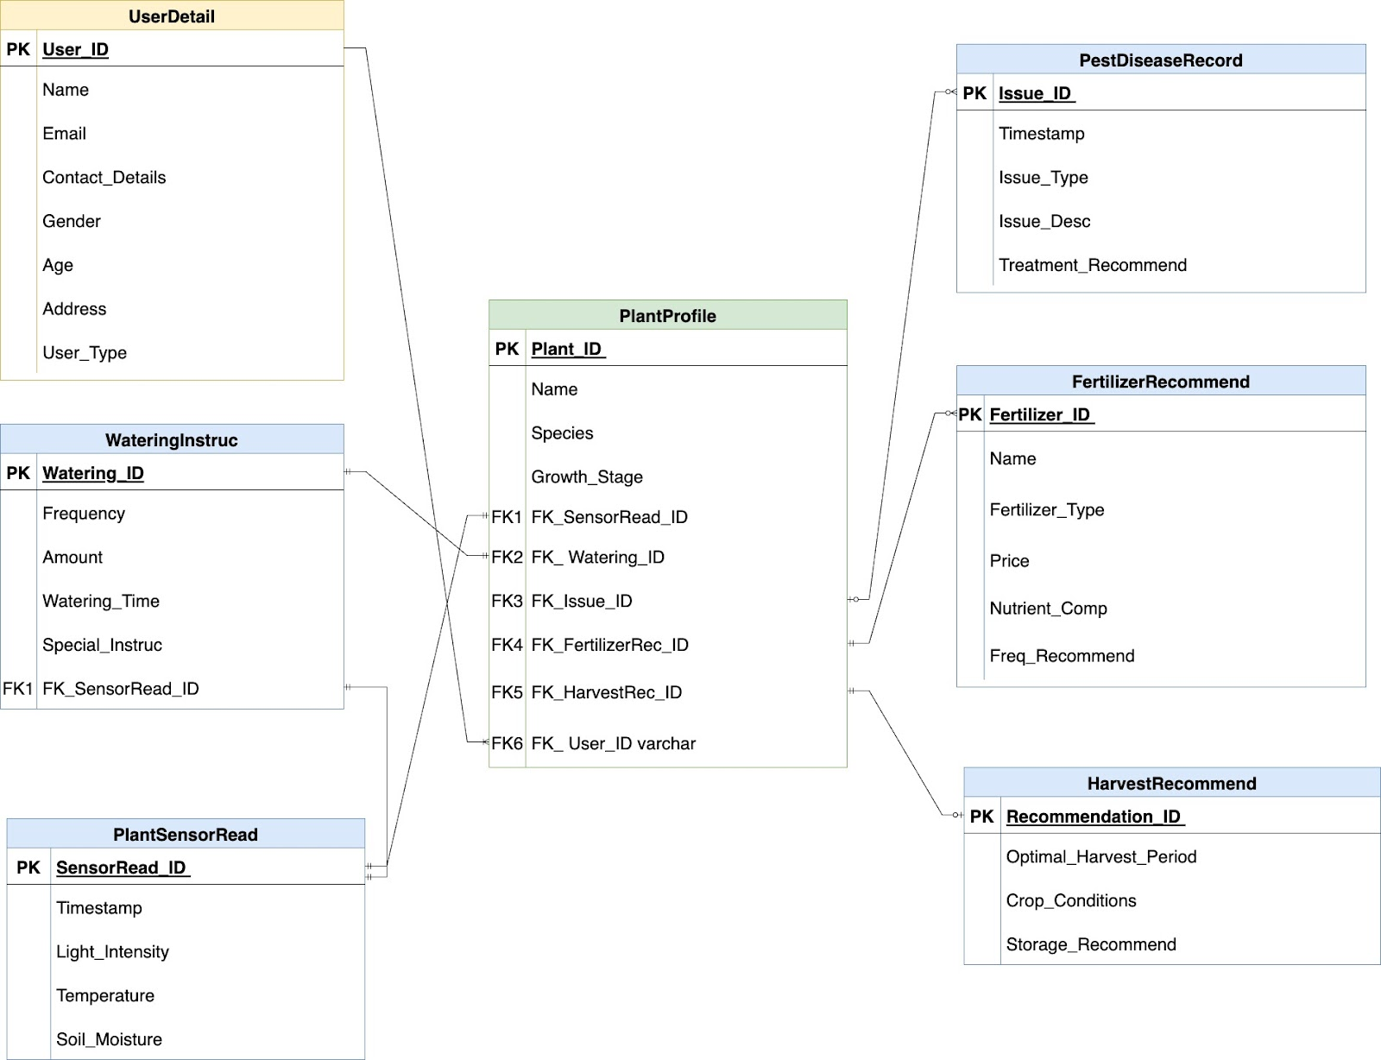
ER Diagram
There are Total 7 Tables
- UserDetail
- PlantProfile
- PestDiseaseRecord
- FertilizerRecommend
- HarvestRecommend
- PlantSensorRead
- WateringInstruc

Slide 8
Business Rules & Facts
1. Multiple Sensor Readings are linked to each Plant Profile (PlantSensorRead), allows for the real-time observation and analysis of particular plant conditions using a variety of sensor readings.
2. Pest and Disease Records (PestDiseaseRecord) are linked to every single Plant Profile, which
makes tracking diseases and pests easier and gives users plant-specific remedies.
3.A USER may regulate multiple PLANT PROFILES, allowing them to manage a wide range of plants
in their collection, each with a distinct set of care requirements.
4. Defined watering schedules for every Plant Profile according to the stage of growth and environmental conditions.
5.The Harvest Recommendations table (HarvestRecommend) linked with each Plant Profile helps users make decisions about crop harvesting by providing the best harvest conditions and timing for particular Plant Profiles.
6.The PlantProfile table, which is linked to FertilizerRecommend, provides a range of fertilizer solutions that are customized to meet the specific needs of various plant varieties.
7. The Watering Guidelines table will be connected to the Sensor Readings table by which watering recommendations are continuously adjusted by considering realtime sensor data, such as
temperature and soil moisture levels.

Slide 9
Business Rules & Facts Cont'd
Major Constraints
- Developing high precision machine learning model as usefulness of the application's recommendations is supported by it.
- User assistance and training to fully utilize the application's features and correctly interpret recommendations.
- Environmental conditions and plant care practices can vary greatly between regions.
Scope For the time being, database implementation has been completed in accordance with course requirements. ML learning model development is not currently a high priority, but it will undoubtedly be included in this project in the near future as the subject is the foundation for database design.

Slide 10
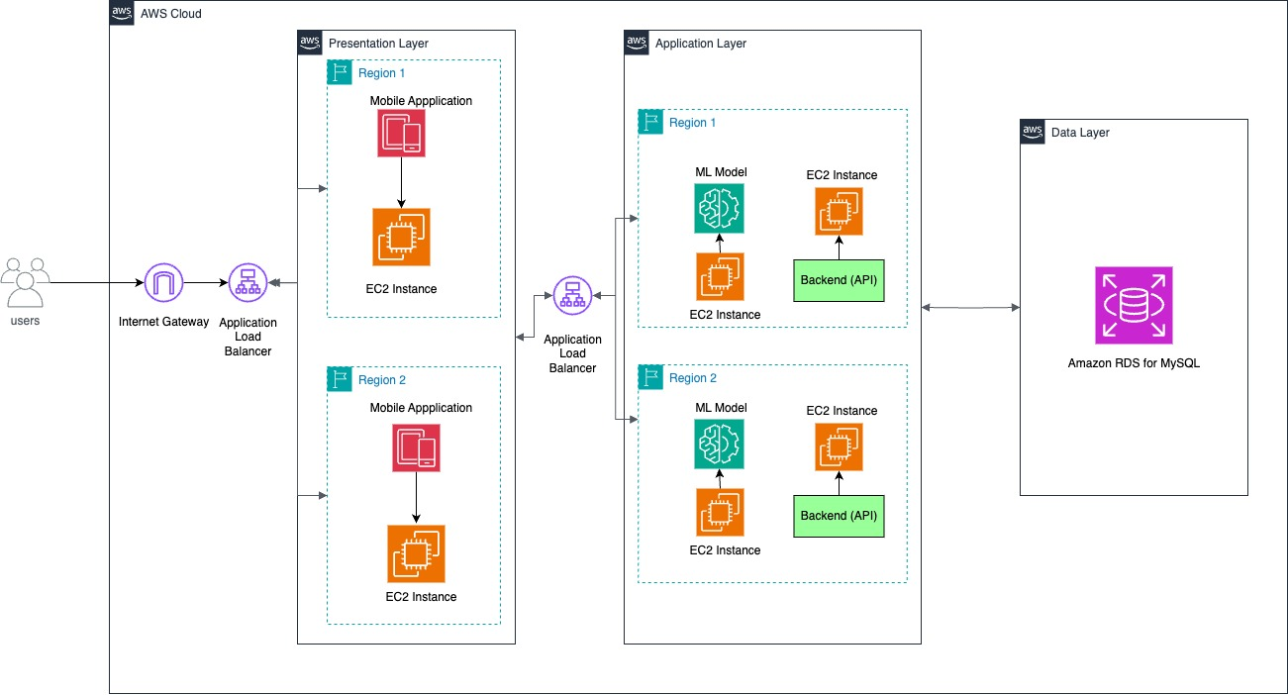
System Architecture
Suggested 3 Tier client/server Architecture

Slide 11
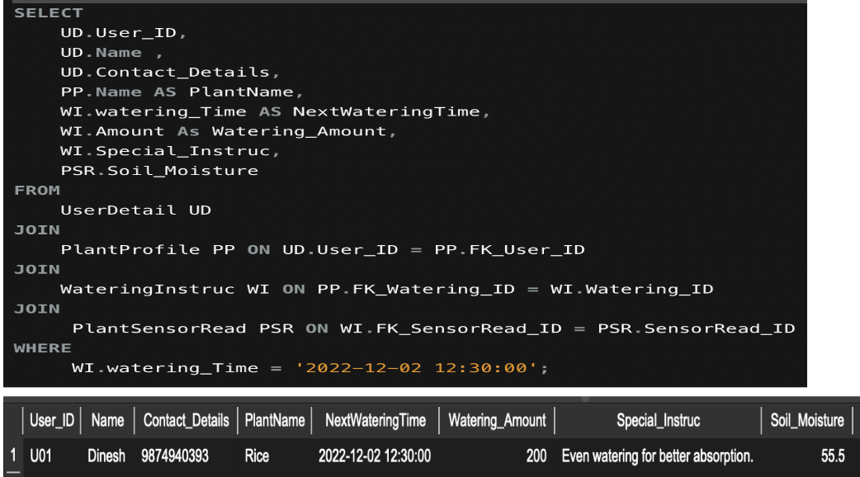
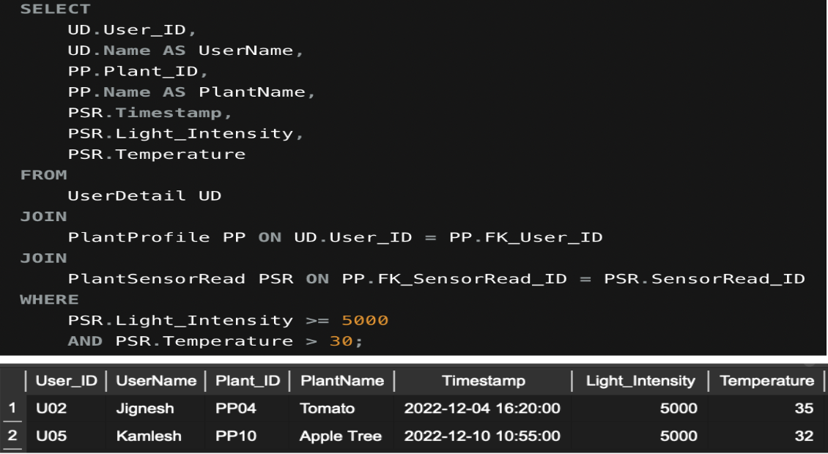
SQL Examples
1. Scheduled Watering Notification
The mentioned SQL query is meant to collect data regarding users who have upcoming watering schedules. I specified a fixed time in the WHERE clause, but we can also utilise SQL methods like GETDATE() to dynamically calculate and select records depending on the current date and time. I've combined four tables to accomplish this: UserDetails, PlantProfile, WateringInstructions, and PlantSensorRead. After receiving the filtered data, the list of users will be utilised to generate notification alerts for their upcoming watering plans.
2. Light and Temperature Alert
The SQL query mentioned fulfil the use-case, which is to obtain user details where their plants' sensors detect that the temperature is above 30 and the light intensity is 5000 Lux or more, it joins three tables: UserDetails, PlantProfile, and PlantSensorRead for the same purpose. Additionally, the where clause is used for fulfilling the temperature and light intensity conditions. After obtaining user information, the system can help users take better care of their plants by providing more general guidance and, if practical, moving the plants to an area with lower light levels. It is only for plants whose growth is hampered by high temperatures or intense light.

Slide 12
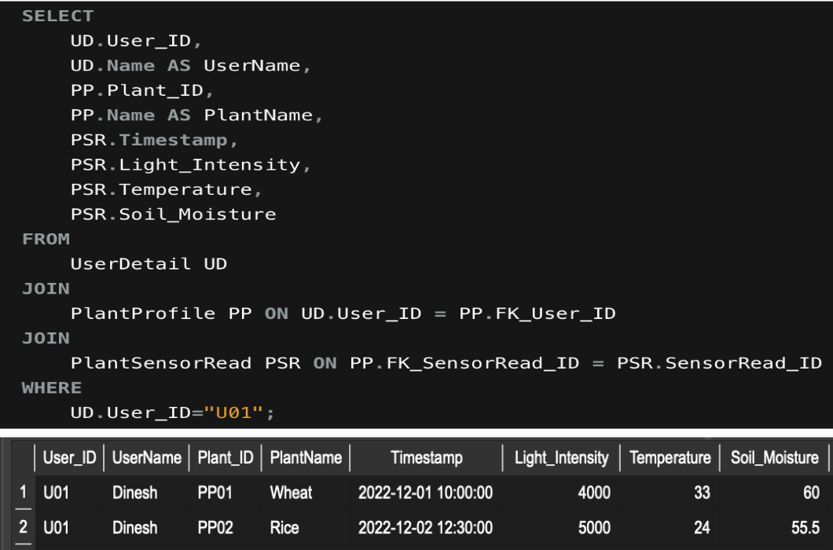
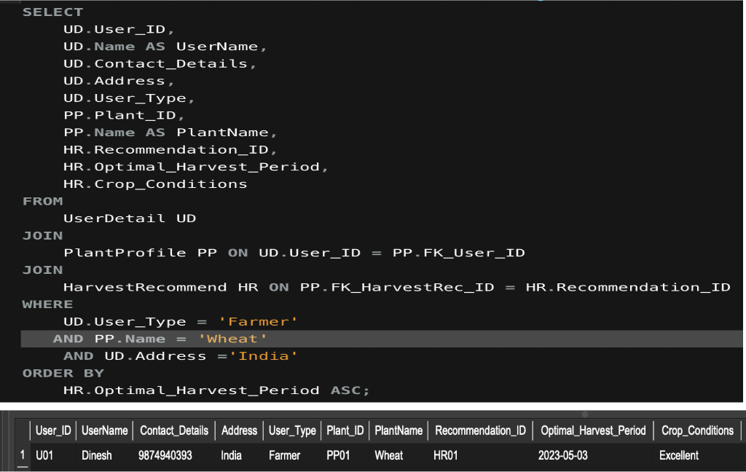
SQL Examples
3. Sensor Reading Check for User (U01)
The SQL statement shown above retrieves all the information a user would need to know about their planted plants' sensor reading. This SQL query will execute and deliver the necessary information based on the user ID specified in the Where clause when the user lands on the page where the plant's sensor record has been displayed. Using relevant IDs, this query joins three tables: UserDetails, PlantProfile, and PlantSensorRead.
4. Botanist Harvest Inquiry
The above-mentioned SQL query gets data for all farmers in India growing wheat, taking into account the nearest harvest period indicated in the WHERE clause and sorting the results in an ascending order using the ORDER BY clause. Three tables—UserDetails, PlantProfile, and HarvestRecommend—are joined using relevant IDs to collect all necessary information. The collected data will be made available to botanists and researchers who might want the same report for their studies. This will allow them to contact farmers to talk about their needs.

Slide 13
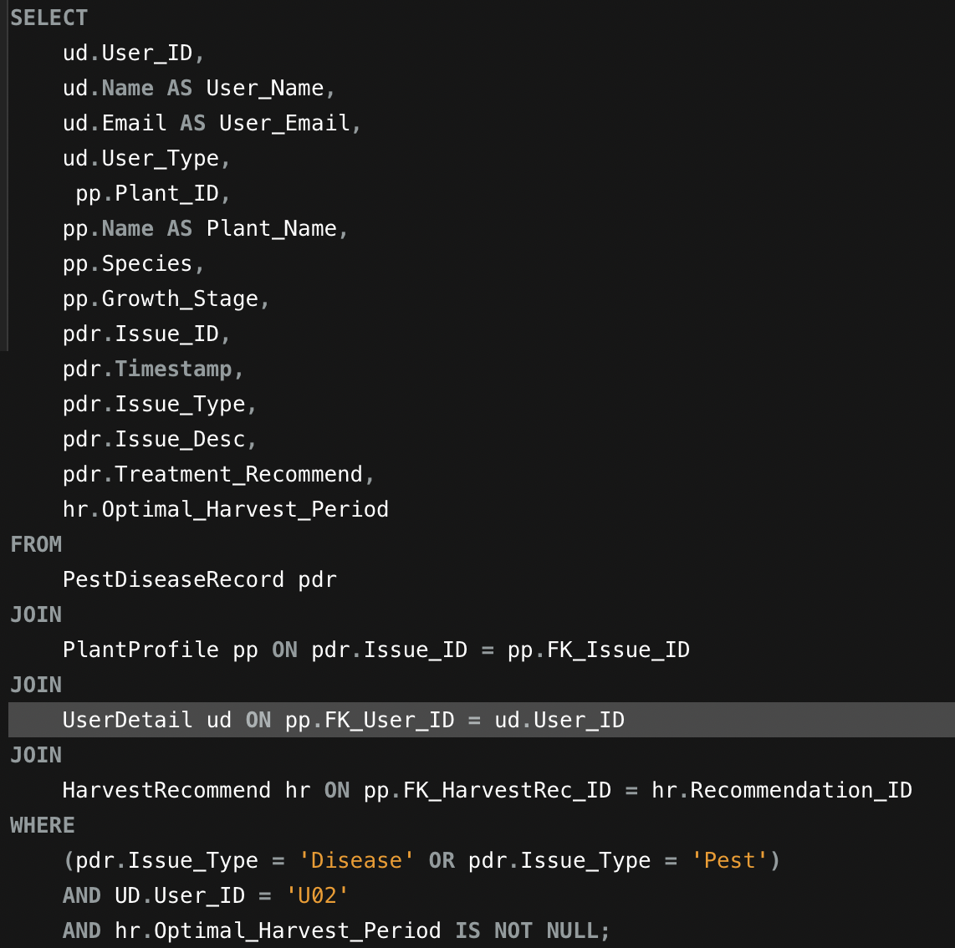
SQL Examples
5. Pest Treatment Alert for User (U02)
The mentioned SQL query gets information that will give the user insight into suggested treatments for their plants. An ML model generates a recommendation when the user provides details about the pest or disease issue. The user is then provided with every relevant detail, including the appropriate harvest time period. This allows the user to do what has to be done in advance of harvest time. Four tables—PestDiseaseRecord, PlantProfile, UserDetails, and HarvestRecommend—are joined to do this. Also, I used the WHERE clause to filter records about diseases or pests for a specific user and to display only records with an appropriate harvest time period (using NOT NULL constrain).

Slide 14
Metrics and Analytics
Gardener Metrics
Examples
Plant Profiles Created (count)
Involvement with Sensor Data (frequency per week)
Treatment Actions Taken (count)
Farmer Metrics
Examples
Improvement in Crop Quality (% Improvement)
Harvest Optimisation (yield per acre)
Watering Economy (amount of water used per
plant)
Botanist Researcher Metrics
Examples
Collaborative Field Studies (count)
Variety of Plant Species Monitored (count)
Supporter of Sustainable Agriculture
Examples
Environmental Impact Reduction (% reduction)
Sustainable Fertilizer Impact Rating (Scale 1-10)
Resource Utilization Insights (count)

Slide 15
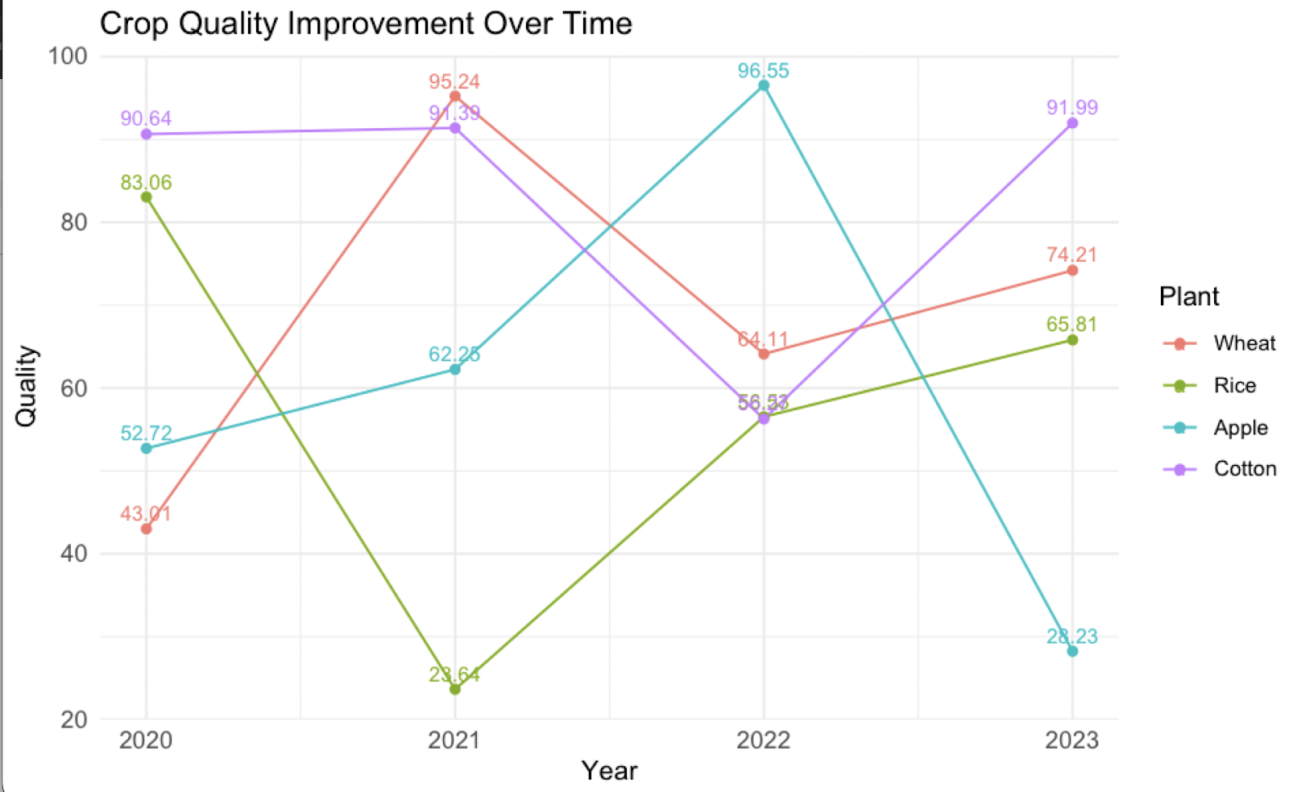
Metrics and Analytics Cont'd.
Note. Users can quickly determine what crop type would be most advantageous for them based on crop quality reports. For instance, cotton consistently produces good-quality crops which continue to rank among the best in 2020 and 2023.

Slide 16
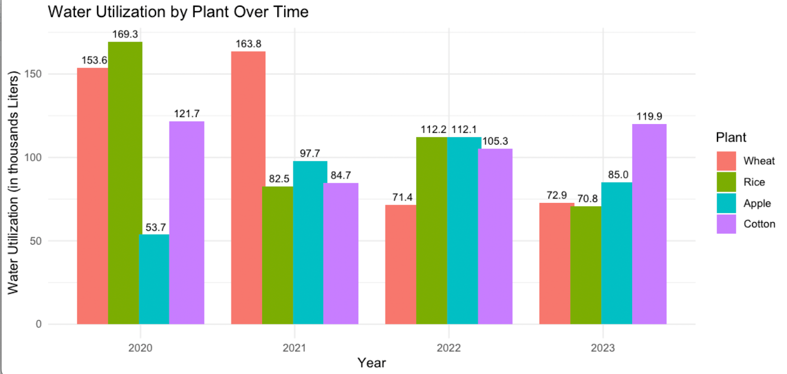
Metrics and Analytics Cont'd.
Note. Another graph discusses water use over the time, and it is evident that cotton uses the least amount of water while maintaining the highest quality, making it a viable option. On the other hand, wheat and rice utilize more amount of water than other crops.

Slide 17
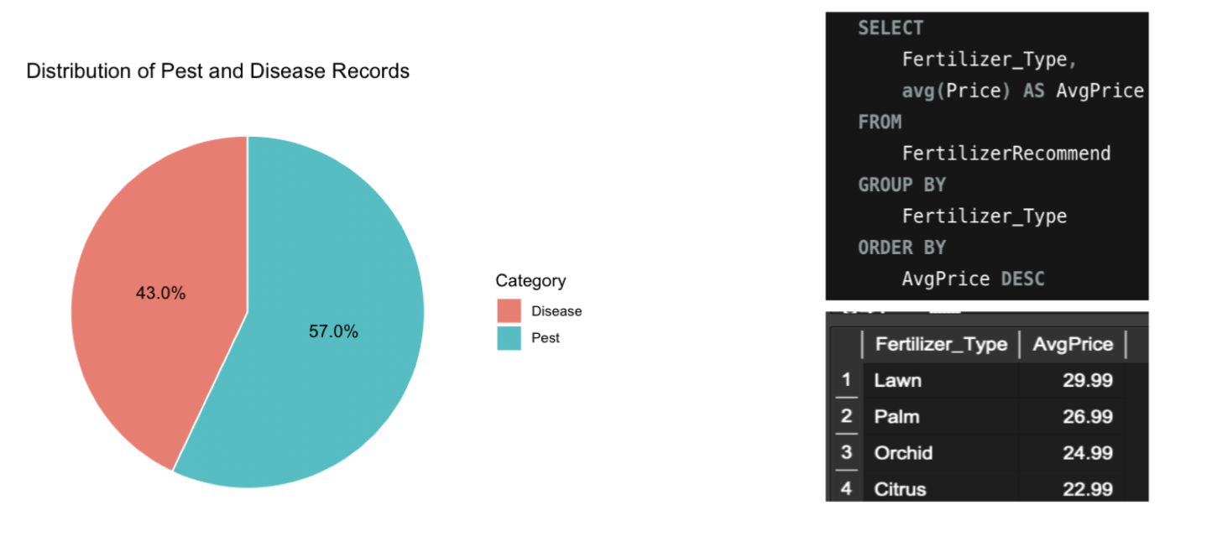
Metrics and Analytics Cont'd.
Note. A quick look at the pie chart revealed that 57% of
users experience pest issues related to their plants. As a result, other users who are researchers can work with
them to find solutions and conduct market research on
pest control.
Note. As the average cost of a lawn fertilizer type is clearly higher than that of any other
the internal team should try to increase the
choice to offer a superior substitute.

Slide 18
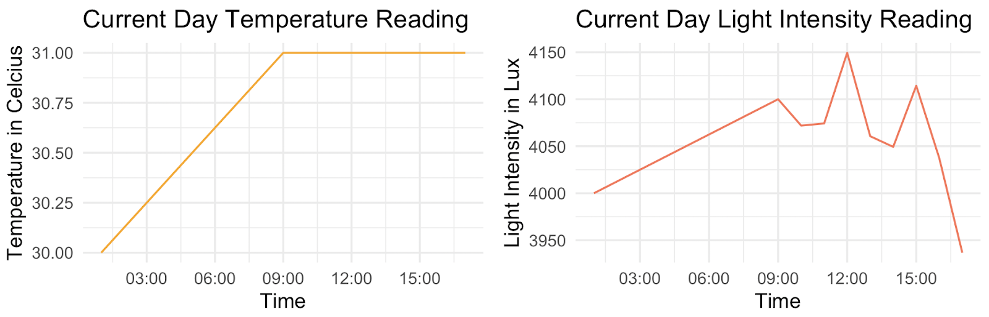
Metrics and Analytics Cont'd.
Note. Temperature and light intensity readings are useful to gardeners. For example, monitoring a rise in
temperature from 30 to 31 degrees Celsius and a change in light intensity from 4000 to 3950 lux allows for the making of well-informed decisions, such as moving plants that require light. However, this would be automating suggestions, which lessens the need for users to make decisions by hand.

Slide 19
Security and Privacy
Solution for Security and Privacy
Identity and Access Management (IAM): Ensures the privacy of information by efficiently managing user permissions.
Endpoint Security : Protects the devices integrity stops possible breaches.
Backup and Recovery : Maintain appropriate data backups and establish recovery procedures to
reduce loss of data in the event of an incident.
Network Segmentation: Separates the network into parts in order to stop security threats from
spreading.
Data Masking: Guaranteed that the full data is only visible to authorised users.
Database Patching and Updates: Updates and patches for the database provide advantages for fixing known vulnerabilities
Sensitive Data and Storing Approach
User Details : Follow Encryption approach to guarantee privacy. Volume: very little personal data.
Recommendation Data: Stored in a secure, hashed format. Volume: For all harvest and treatment records.
Sensor Read Data : Maintained in anonymized format. Volume: For. 1 for Every Plant record.

Slide 20
Security and Privacy Cont'd.
Information that hackers may target.
Recommendation Data Unauthorised access may result in recommendations being manipulated, which would
compromise the system's integrity.
Sensor Data
Sensor data manipulation could lead to significant losses, particularly for farmers.
User Information
A breach could result in a variety of threats, including identity theft, Scams and Phishing, and fraudulent activity.

Slide 21
Next steps / Lessons Learned
Take Aways
- I learned about the principles of effective database design and fully understood the importance of business rules and logic in database development.
- Applied iterative design to create an organised ER diagram and learned to put the database development into practice by utilising the created ER diagram
- Understood the principles of client-server architecture for project development. studied privacy and security guidelines for a database system that runs smoothly.
Next Steps
- When I have the opportunity to learn more about ML modelling later in the course, I'll try to develop a significant ML recommendation model that will aid in producing recommendations for both harvesting and plant disease treatments.

Slide 22
References
ECO gardener. (2023, August 7). 8 Common Gardening Challenges and How to Solve Them. ECOgardener. Retrieved November 20, 2023, from https://ecogardener.com/blogs/news/8-gardening-challenges-and-how-to-solve-them
M, D. (2023, March 13). 11 Major Problems Faced By Indian Farmers In Agriculture In 2023. Bighaat. Retrieved November 20, 2023, from https://kisanvedika.bighaat.com/news-updates/11-major-problems-faced-by-indian-farmers-in-agriculture-in-2023/

Slide 23
Thank You!!

